Slide 1


100,000 Opportunities Demonstration Cities Pathways to Careers Fund
Seattle/King County Informational Webinar
January 17, 2017

Slide 2
Webinar Overview
The Aspen Forum for Community Solutions & Opportunity Youth Incentive Fund
Seattle/King County 100K Demonstration City Operational Plan
Pathways to Careers Fund Learning Objectives & Grantee Requirements
Questions

Slide 3
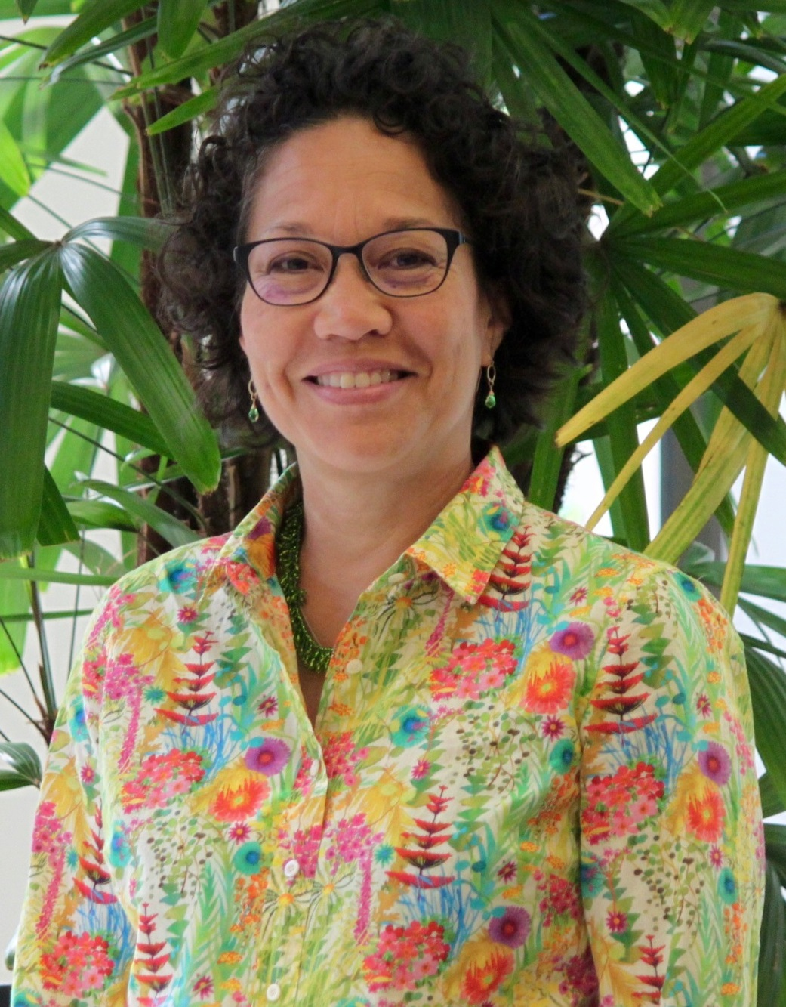
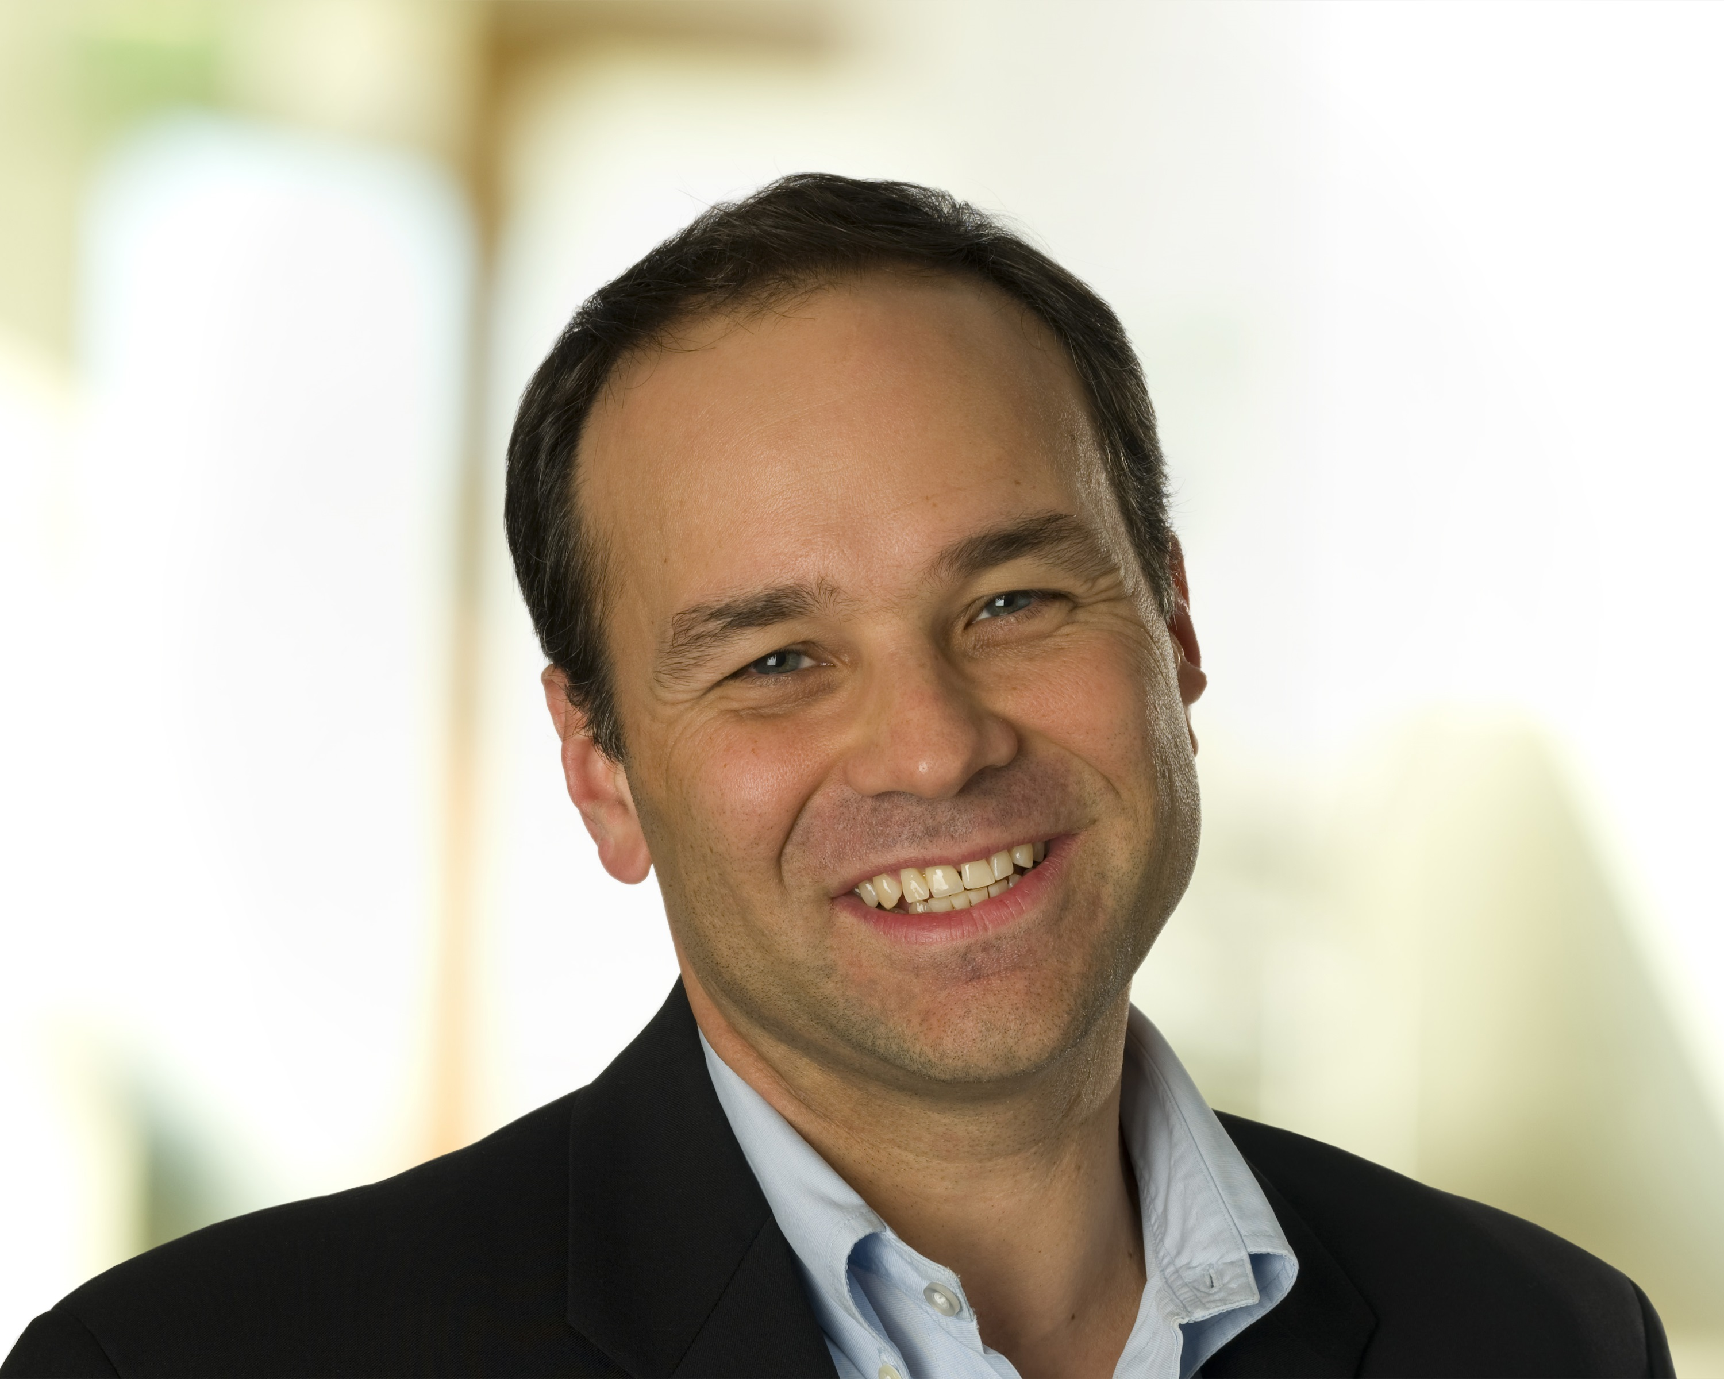
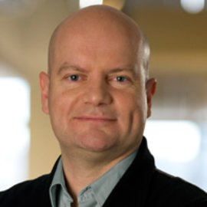
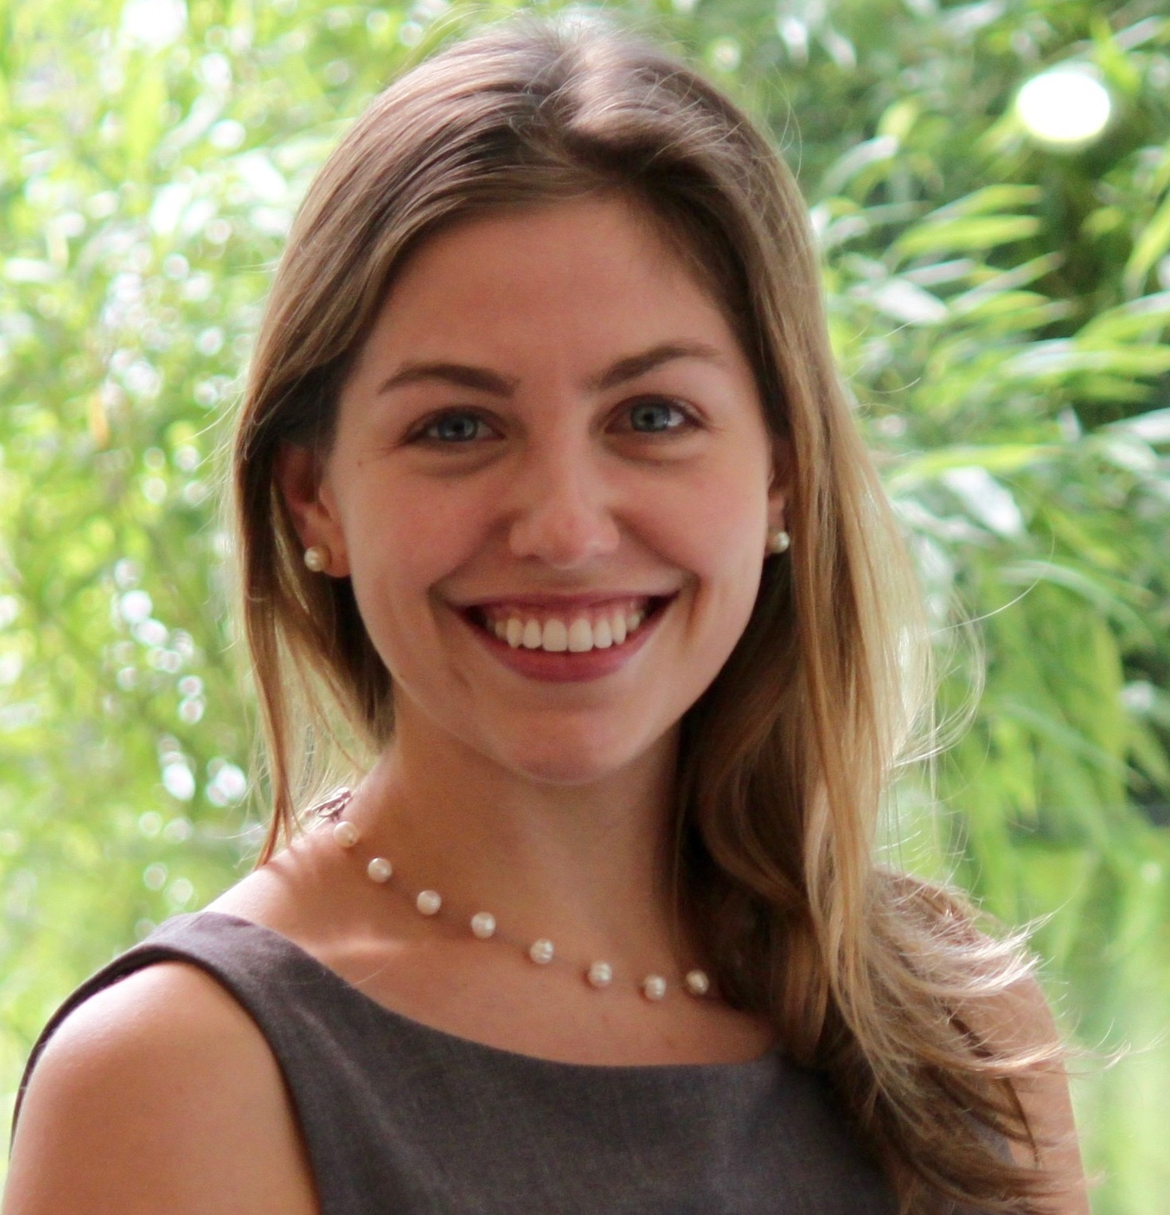
Who We Are
MARIKO LOCKHART
National Coordinator
100K Demonstration Cities
STEVE PATRICK
Vice President and Executive Director
KEN THOMPSON
Senior Fellow
EMMA UMAN
Program Manager
100K Demonstration Cities

Slide 4

Our Work
100,000 Opportunities Initiative Demonstration Cities (2015)
Coordinate education and training providers and align with private sector commitment to hire opportunity youth in 5 communities
Three initiatives, one vision
Opportunity Works (2014)
Build evidence base of what works to improve the credential attainment of opportunity youth in 7 communities with emphasis on boys and men of color
Pathways to Careers Fund
Create, accelerate and expand innovative career pathways for opportunity youth
Opportunity Youth Incentive Fund (2012)
Support backbone organizations in 21 communities to build and deepen pathways to education and employment for opportunity youth
Tree visual from https://johnwoodcockillustration.wordpress.com

Slide 5
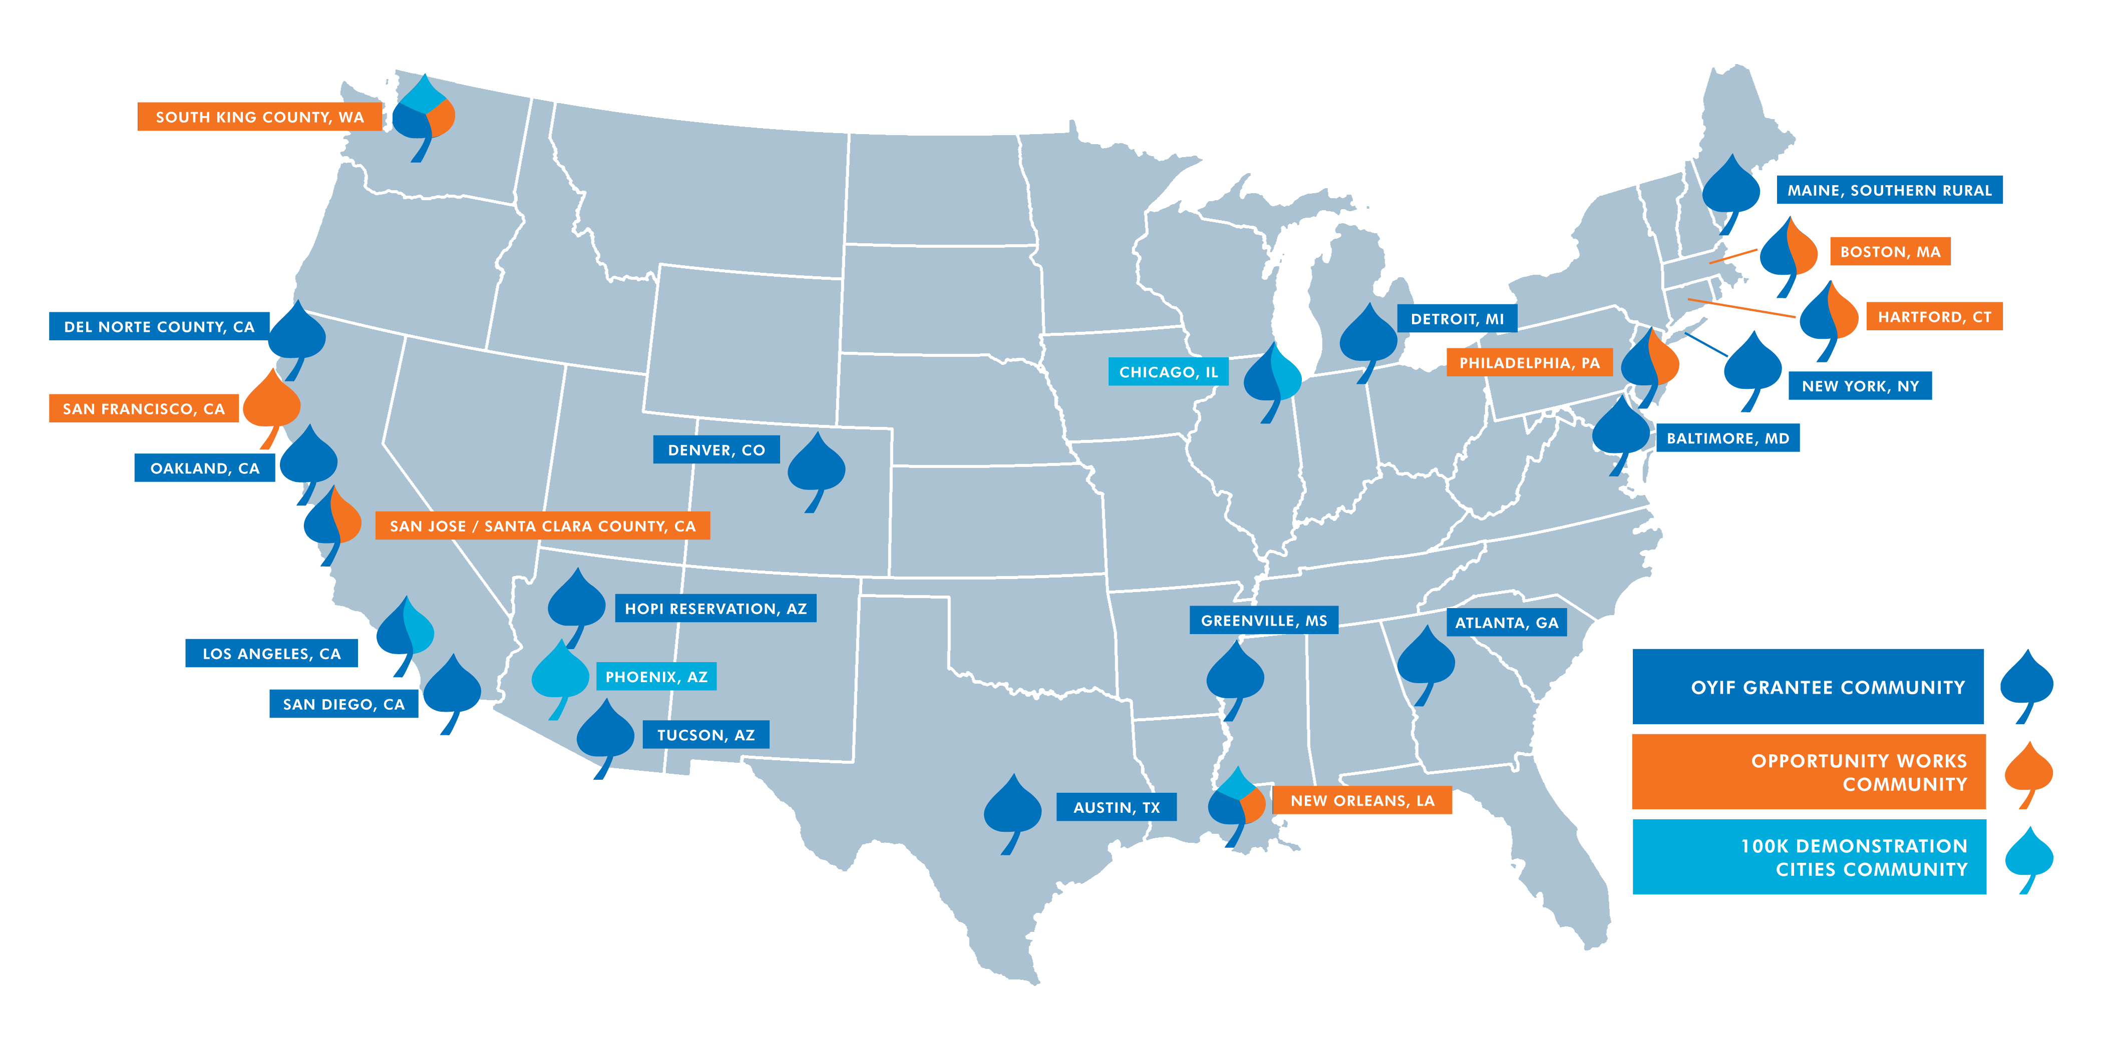
Our Communities

Slide 6
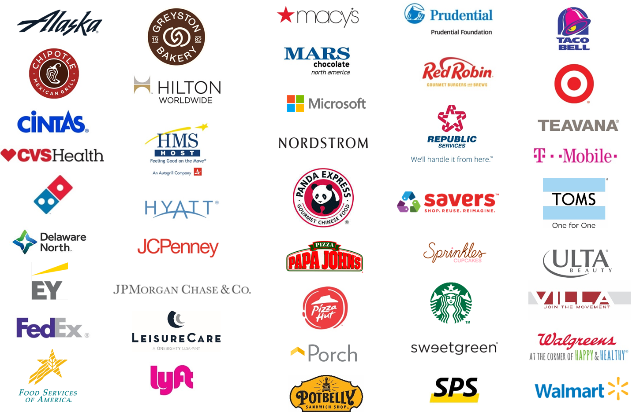
100,000 Opportunities Initiative
Employer Coalition
Notes:
In 2015, Starbucks stepped up in an unprecedented way and began recruiting other companies to join them to focus on opportunity youth. Now, thanks to the leadership of Starbucks & SFF, the 100K Coalition has now grown to include over 45 US-based companies

Slide 7
100,000 Opportunities Demonstration Cities
Key Strategies
Support a robust cross-system collaborative effort coordinated by backbone partners
National learning community and technical assistance
Documentation and codification captured and shared with the field
Direct investment to bridge supply and demand to create employer-connected pathways
Notes:
In partnership with 100K, made a commitment to longer term work in 5 communities to better align systems, create new pathways. Deeply committed to the backbone role, but also recognized that to really take advantage of this moment, want to also support partnerships between training providers and employers. I think of it as a chemical reaction…we have the right elements, but with a catalyst the reaction will happen a lot quicker!

Slide 8


100,000 Opportunities Demonstration Cities
Seattle/King County Backbone Partners

Slide 9
Seattle/King County 100K Regional Plan
Focus Areas
  Support Opportunity Fairs in the Region
  Connect Low-Income College and Re-Engagement Students with Education-Friendly Jobs
  Develop and Promote Creative Advancement Strategies Within and Across Employers
  Explore Piloting the Customer Service Excellence Training Curriculum
  Capture and Communicate Success Stories

Slide 10
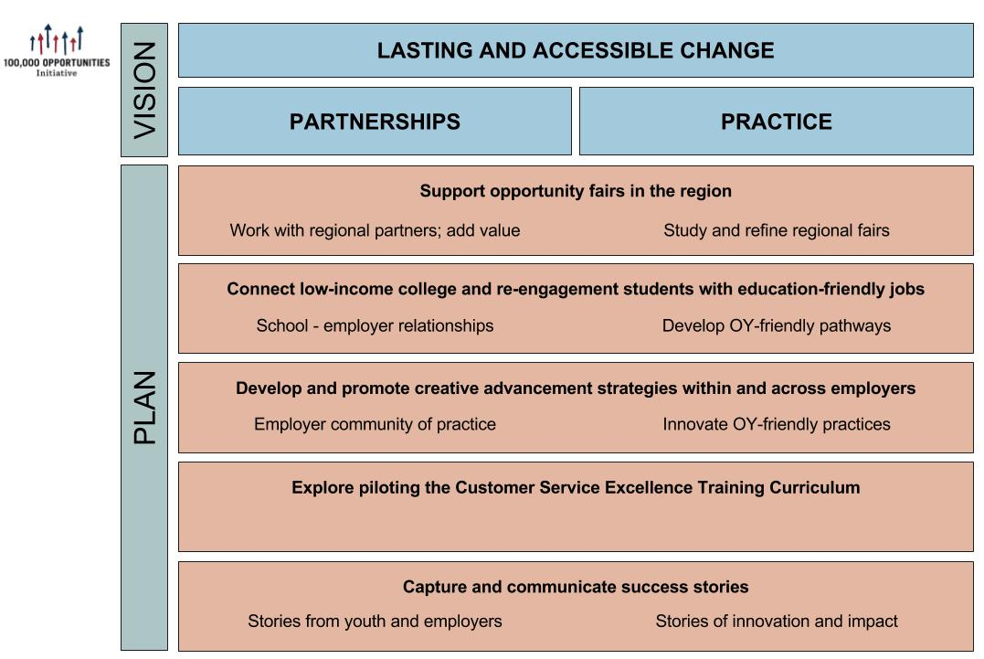
Seattle/King County 100K Regional Plan

Slide 11
Pathways to Careers Fund
Eligibility Criteria
Projects must be implemented in Seattle/King County
Projects must be completed within 24 months of the start date
Projects must include collaboration with at least one employer
The applicant must be a non-profit organization
All applicants must be willing to collect and share summary data with Aspen, its evaluation partners, and the Demonstration Community backbone organizations, and have information about their project shared. All grantees of the Pathways Fund must be willing to participate in a third-party evaluation conducted by Equal Measure.

Slide 12
Pathways to Careers Fund
Preferred Eligibility Criteria
Focus on innovating around “work-friendly” education and training programs or “education-friendly” employment (effectively combining work and educational attainment)
Support retention, persistence, and opportunities to advance in employment
Feature employers as designers or co-designers
Scale an existing proven effort
Focus on reducing racial inequities in employment and/or education outcomes

Slide 13
Pathways to Careers Fund Learning Plan
Our goal is learning for continuous improvement, not reporting/evaluation for compliance or grant management purposes
We understand that reporting and evaluation can be a burden for grantees, and will seek to minimize time needed for these activities
We respect client privacy and do not request any identifiable information at the individual level

Slide 14
Pathways to Careers Fund Learning Plan
Sample Learning Questions
Project level
Did investments/projects succeed in achieving youth outcomes and/or any systems change outcomes sought?
What lessons were learned in regards to what did or didn’t work during implementation?

Slide 15
Pathways to Careers Fund Learning Plan
Sample Learning Questions
Multi-site (summary) level
Did the projects happening in a region support and enhance that region’s OY agenda?
For employers, what are the largest challenges of doing this kind of work? Did projects help to move employers to create lasting, long term changes to hiring approaches?
Did increases in scale (eg. total number of OY employed) or quality (eg. persistence of OY in jobs) stick after the project period? Why or why not?
Were approaches that executed on combining educational progress and job progress concurrently more or less effective than approaches that were solely about jobs?

Slide 16
Pathways to Careers Fund Learning Plan
Required Grantee Activities
Interviews with AFCS evaluation partner: twice a year, a one hour interview with an evaluation partner.
Participation in learning sessions in your city, with AFCS staff: at most twice a year, participation in a half day learning discussion with other grantees.
Written report: an annual and/or final report will be required, which will include reporting data on actual youth outcomes as they relate your proposed outcomes, and a narrative describing the process you used and successes and barriers you experienced.
At the end of your project: potential phone interview with evaluators or AFCS staff.
We estimate that our request to grantees for time related to learning should amount to less than 12 hours annually

Slide 17
Applying to the Pathways to Careers Fund
Proposal Components
Seattle/King County Application Cover Sheet
Proposal Narrative (not to exceed 8 pages; your response to section 1 should not exceed 1 page), including the completed diagram shown in Appendix D of the RFP
Letters of commitment and/or Memoranda of Understanding from employer partners of the proposed pathway or otherwise needed for the success of the project.
If a K12 or post-secondary connected pathway, letters of commitment and/or Memoranda of Understanding from any educational institution partners.
If the proposed pathway has any existing documentation of the approach or outcomes (descriptive report, evaluation, etc) please include as an attachment.
Copy of organization’s 501(c)3 letter; if organization is applying as a fiscal sponsor for another organization, also include a copy of the fiscal sponsorship agreement

Slide 18
Applying to the Pathways to Careers Fund
Submission Process
Proposals are due, by electronic submission, to the attention of: Emma Uman, emma.uman@aspeninst.org
Deadline for submission is February 24, 2017 6:00 p.m. Pacific Time
Funding decisions will be announced before May 31, 2017

Slide 19
Questions?

