Slide 1


100,000 Opportunities Demonstration Cities Pathways to Careers Fund
New Orleans Informational Webinar
January 19, 2017

Slide 2
Webinar Overview
The Aspen Forum for Community Solutions & Opportunity Youth Incentive Fund
New Orleans/EMPLOY Collaborative Strategy
Pathways to Careers Fund Learning Objectives & Grantee Requirements
Questions

Slide 3



Who We Are
NICOLE JOLLY
Senior Program Manager, EMPLOY
Cowen Institute, Tulane University
KEN THOMPSON
Senior Fellow
Aspen Forum for Community Solutions
EMMA UMAN
Program Manager
100K Demonstration Cities, Aspen Forum for Community Solutions

Slide 4

Our Work
100,000 Opportunities Initiative Demonstration Cities (2015)
Coordinate education and training providers and align with private sector commitment to hire opportunity youth in 5 communities
Three initiatives, one vision
Opportunity Works (2014)
Build evidence base of what works to improve the credential attainment of opportunity youth in 7 communities with emphasis on boys and men of color
Pathways to Careers Fund
Create, accelerate and expand innovative career pathways for opportunity youth
Opportunity Youth Incentive Fund (2012)
Support backbone organizations in 21 communities to build and deepen pathways to education and employment for opportunity youth
Tree visual from https://johnwoodcockillustration.wordpress.com

Slide 5
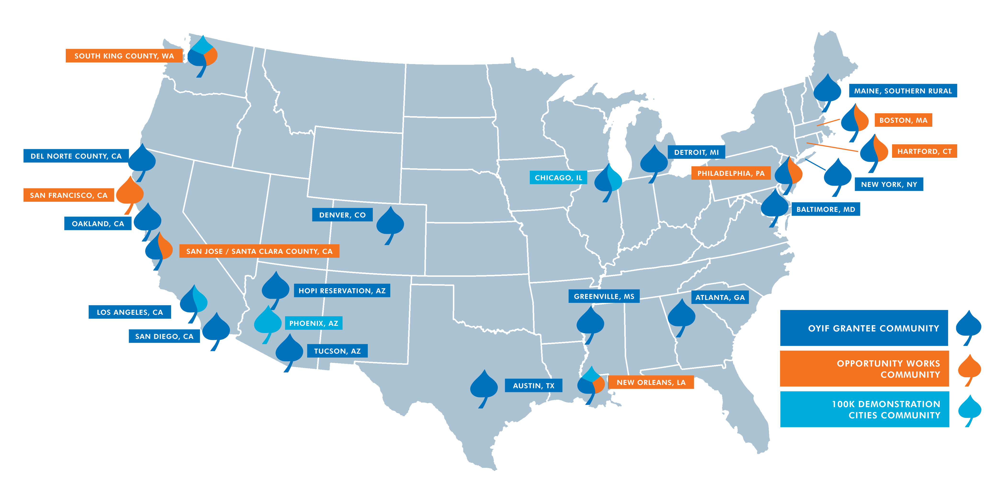
Our Communities

Slide 6
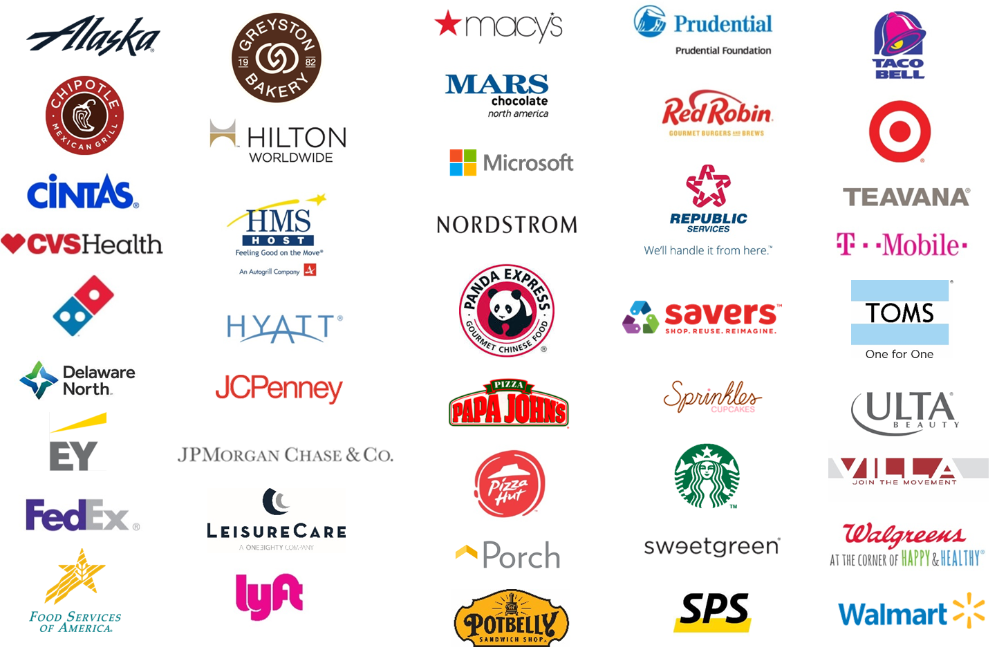
100,000 Opportunities Initiative
Employer Coalition
Notes:
In 2015, Starbucks stepped up in an unprecedented way and began recruiting other companies to join them to focus on opportunity youth. Now, thanks to the leadership of Starbucks & SFF, the 100K Coalition has now grown to include over 45 US-based companies

Slide 7
100,000 Opportunities Demonstration Cities
Key Strategies
Support a robust cross-system collaborative effort coordinated by backbone partners
National learning community and technical assistance
Documentation and codification captured and shared with the field
Direct investment to bridge supply and demand to create employer-connected pathways
Notes:
In partnership with 100K, made a commitment to longer term work in 5 communities to better align systems, create new pathways. Deeply committed to the backbone role, but also recognized that to really take advantage of this moment, want to also support partnerships between training providers and employers. I think of it as a chemical reaction…we have the right elements, but with a catalyst the reaction will happen a lot quicker!

Slide 8


100,000 Opportunities Demonstration Cities
New Orleans Backbone Partner/Collaborative

Slide 9

EMPLOY is a cross-sector collaborative working to decrease the number of disconnected youth in New Orleans by engaging them in quality education and employment pathways. We envision a community where all young people in New Orleans are able to realize their educational and employment potential.
Long-term Impact: Fewer youth in New Orleans are disconnected from education and employment.
C. More opportunity youth are employed toward high-wage, high-demand pathways.
B. More youth obtain high school diploma or equivalency and complete postsecondary education and/or training.
A. Opportunity youth receive high-quality supports necessary to progress along education and career pathways.

Slide 10
New Orleans 100K Demonstration City Plan
Engage Committed Employers
  Employer learning community engages local and corporate employers in professional development to improve opportunity youth hiring and retention strategies.
Expose Opportunity Youth to Career Pathways and Opportunities
  Introduce young people and practitioners to high-growth, high-demand career pathways through career exploration with industry professionals.
  Share specific information about earnings, entry and advancement requirements, and other details through career pathway materials and virtual mediums.
Connect Opportunity Youth to Training and Services
  Enroll opportunity youth on-site in job readiness and job training programs.
  Connect opportunity youth on-site to supportive services, inclusive of housing, legal, and childcare.
Hire Opportunity Youth
  200 opportunity youth receive on-the-spot job offers.
  Track retention at 30, 60, 90 days.
Increase Public Awareness of Opportunity Youth and the Initiative
  Provide platforms for opportunity youth to voice their experiences to the community and employers through a round-table event, as well as the event and publicity.
  Expose the mission and strategy of EMPLOY through event publicity and event.

Slide 11
Pathways to Careers Fund
Eligibility Criteria
Projects must be implemented in New Orleans–Metairie–Kenner MSA
Projects must be completed within 24 months of the start date
Projects must include collaboration with at least one employer
The applicant must be a non-profit organization
All applicants must be willing to collect and share summary data with Aspen, its evaluation partners, and the Demonstration City backbone organization, and have information about their project shared. All grantees of the Pathways Fund must be willing to participate in a third-party evaluation conducted by Equal Measure

Slide 12
Pathways to Careers Fund
Preferred Eligibility Criteria
Focus on the pathways in the hospitality sector
Support retention, persistence, and opportunities to advance in employment
Feature employers as designers or co-designers
Scale an existing proven effort
Demonstrate innovation in pathway design
Focus on reducing racial inequities in employment and/or education outcomes

Slide 13
Pathways to Careers Fund Learning Plan
Our goal is learning for continuous improvement, not reporting/evaluation for compliance or grant management purposes
We understand that reporting and evaluation can be a burden for grantees, and will seek to minimize time needed for these activities
We respect client privacy and do not request any identifiable information at the individual level

Slide 14
Pathways to Careers Fund Learning Plan
Sample Learning Questions
Project level
Did investments/projects succeed in achieving youth outcomes and/or any systems change outcomes sought?
What lessons were learned in regards to what did or didn’t work during implementation?

Slide 15
Pathways to Careers Fund Learning Plan
Sample Learning Questions
Multi-site (summary) level
Did the projects happening in a region support and enhance that region’s OY agenda?
For employers, what are the largest challenges of doing this kind of work? Did projects help to move employers to create lasting, long term changes to hiring approaches?
Did increases in scale (eg. total number of OY employed) or quality (eg. persistence of OY in jobs) stick after the project period? Why or why not?
Were approaches that executed on combining educational progress and job progress concurrently more or less effective than approaches that were solely about jobs?

Slide 16
Pathways to Careers Fund – Aspen Learning Plan
Required Grantee Activities
Interviews with AFCS evaluation partner: twice a year, a one hour interview with an evaluation partner
Participation in learning sessions in your city, with AFCS staff: at most twice a year, participation in a half day learning discussion with other grantees
Written report: an annual and/or final report will be required, which will include reporting data on actual youth outcomes as they relate your proposed outcomes, and a narrative describing the process you used and successes and barriers you experienced
At the end of your project: potential phone interview with evaluators or AFCS staff
We estimate that our request to grantees for time related to learning should amount to less than 12 hours annually

Slide 17
Applying to the Pathways to Careers Fund
Proposal Components
New Orleans Application Cover Sheet
Proposal Narrative (not to exceed 8 pages; your response to section 1 should not exceed 1 page), including the completed diagram shown in Appendix D of the RFP
Letters of commitment and/or Memoranda of Understanding from employer partners of the proposed pathway or otherwise needed for the success of the project
If a K12 or post-secondary connected pathway, letters of commitment and/or Memoranda of Understanding from any educational institution partners
If the proposed pathway has any existing documentation of the approach or outcomes (descriptive report, evaluation, etc) please include as an attachment
Copy of organization’s 501(c)3 letter; if organization is applying as a fiscal sponsor for another organization, also include a copy of the fiscal sponsorship agreement

Slide 18
Applying to the Pathways to Careers Fund
Submission Process
Proposals are due, by electronic submission, to the attention of: Emma Uman, emma.uman@aspeninst.org
Deadline for submission is March 3, 2017 6:00 p.m. Pacific Time
Funding decisions will be announced before May 31, 2017

Slide 19
Questions?

