Slide 1


100,000 Opportunities Demonstration Cities Pathways to Careers Fund
Chicago/Cook County Informational Webinar
January 23, 2017

Slide 2
Webinar Overview
The Aspen Forum for Community Solutions & Opportunity Youth Incentive Fund
Thrive Chicago’s Strategy
Pathways to Careers Fund Learning Objectives & Grantee Requirements
Questions

Slide 3
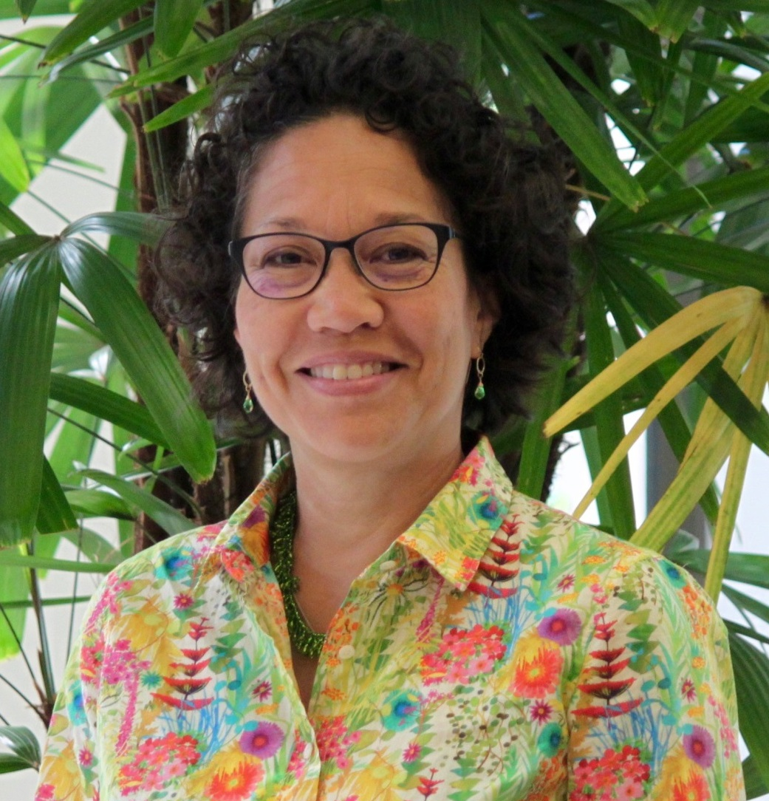

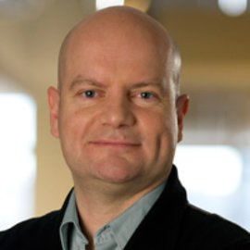
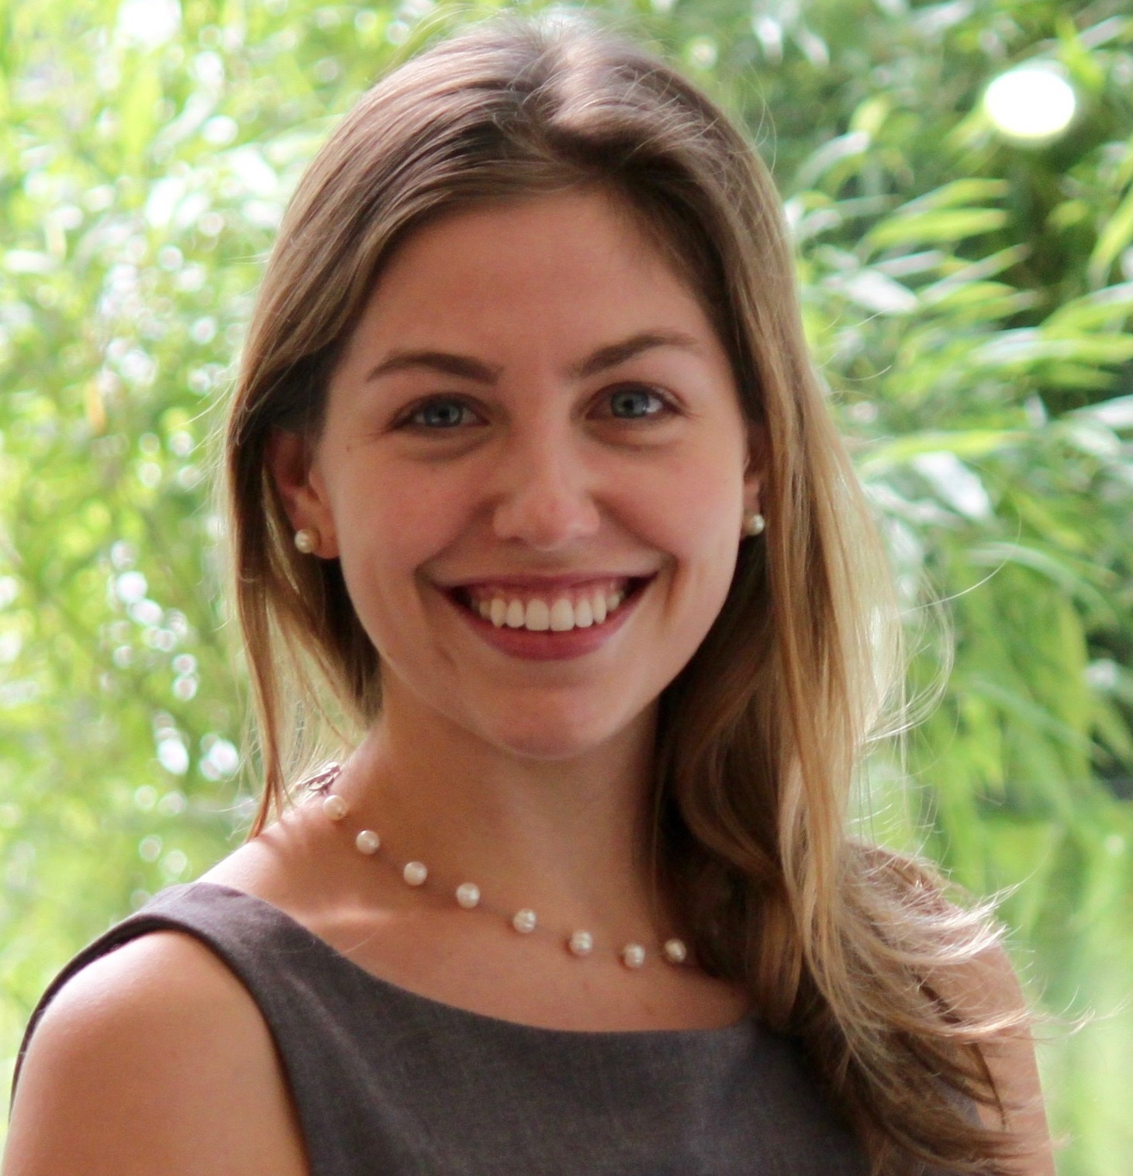
Who We Are
MARIKO LOCKHART
National Coordinator,
100K Demonstration Cities
Aspen Forum for Community Solutions
AMRIT MEHRA
Manager of Workforce Initiatives
Thrive Chicago
EMMA UMAN
Program Manager,
100K Demonstration Cities
Aspen Forum for Community Solutions
KEN THOMPSON
Senior Fellow
Aspen Forum for Community Solutions

Slide 4

Our Work
100,000 Opportunities Initiative Demonstration Cities (2015)
Coordinate education and training providers and align with private sector commitment to hire opportunity youth in 5 communities
Three initiatives, one vision
Opportunity Works (2014)
Build evidence base of what works to improve the credential attainment of opportunity youth in 7 communities with emphasis on boys and men of color
Pathways to Careers Fund
Create, accelerate and expand innovative career pathways for opportunity youth
Opportunity Youth Incentive Fund (2012)
Support backbone organizations in 21 communities to build and deepen pathways to education and employment for opportunity youth
Tree visual from https://johnwoodcockillustration.wordpress.com

Slide 5
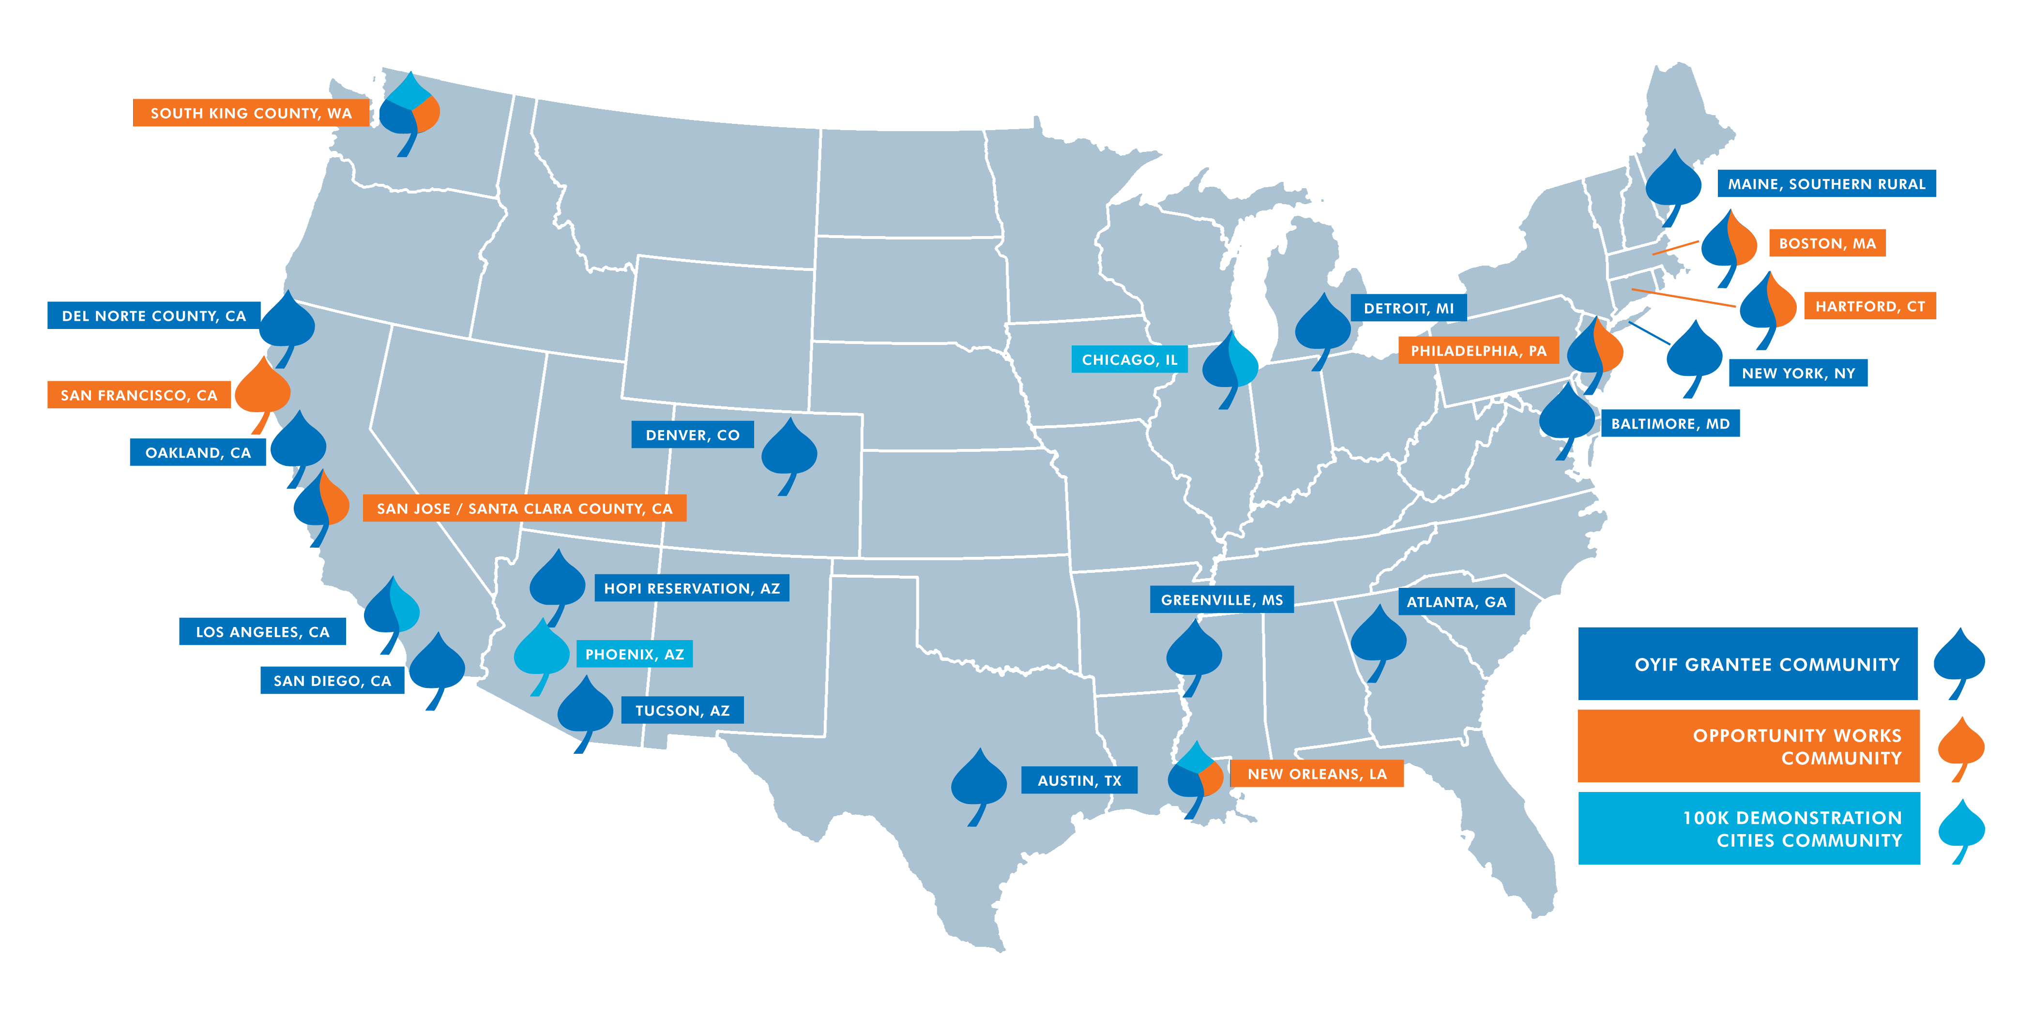
Our Communities

Slide 6
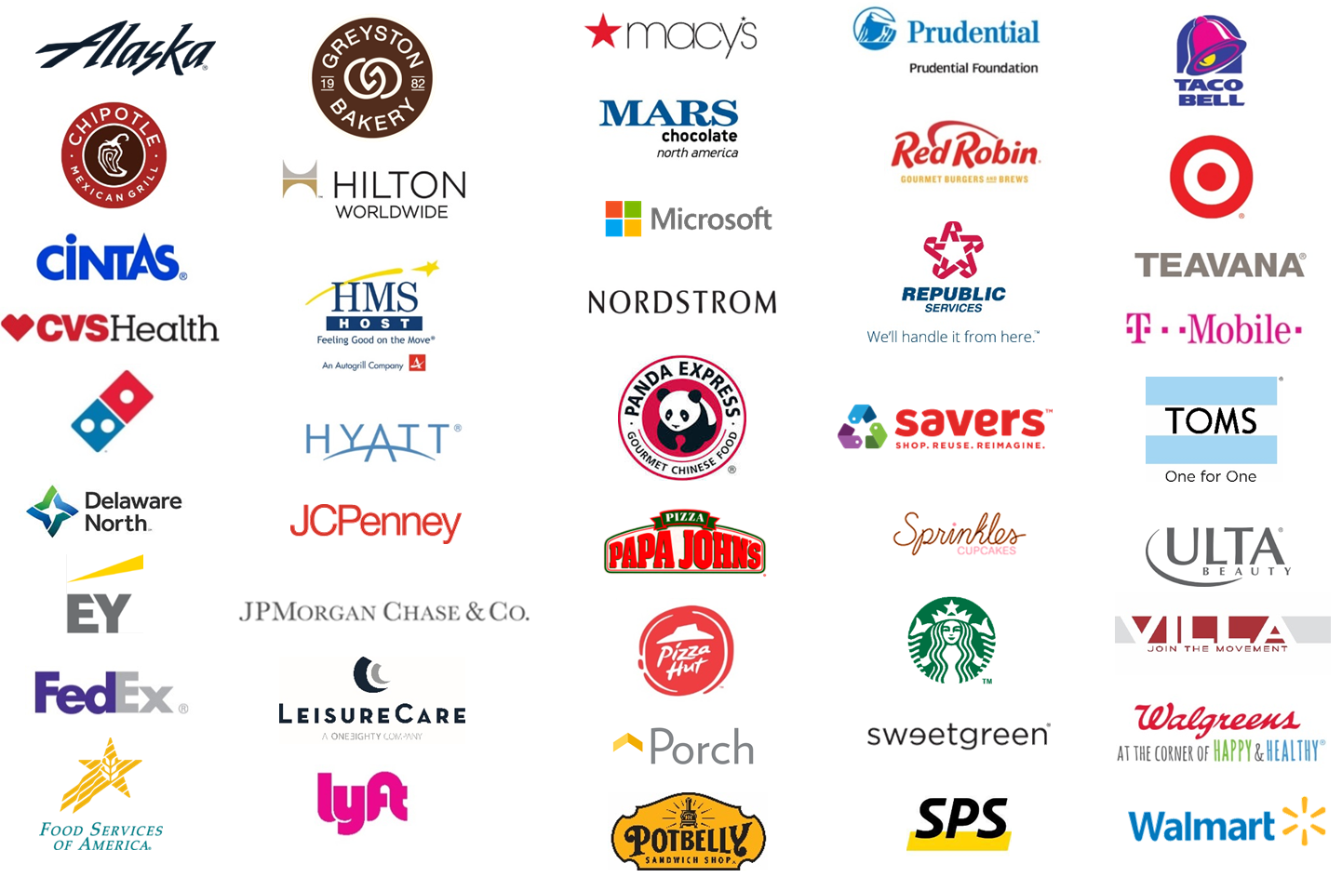
100,000 Opportunities Initiative
Employer Coalition
Notes:
In 2015, Starbucks stepped up in an unprecedented way and began recruiting other companies to join them to focus on opportunity youth. Now, thanks to the leadership of Starbucks & SFF, the 100K Coalition has now grown to include over 45 US-based companies

Slide 7
100,000 Opportunities Demonstration Cities
Key Strategies
Support a robust cross-system collaborative effort coordinated by backbone partners
National learning community and technical assistance
Documentation and codification captured and shared with the field
Direct investment to bridge supply and demand to create employer-connected pathways
Notes:
In partnership with 100K, made a commitment to longer term work in 5 communities to better align systems, create new pathways. Deeply committed to the backbone role, but also recognized that to really take advantage of this moment, want to also support partnerships between training providers and employers. I think of it as a chemical reaction…we have the right elements, but with a catalyst the reaction will happen a lot quicker!

Slide 8

100,000 Opportunities Demonstration Cities
Chicago Backbone Partner/Collaborative
Notes:
Hi, everyone. My name is Amrit Mehra and I am the Manager of Workforce Initiatives at Thrive Chicago.
For those of you not familiar with us, Thrive is the only citywide collective impact backbone organization focused on youth in Chicago. We were launched in 2013 and became an independent organization the following year.

Slide 9
  ACTIVATE
  RESEARCH + DATA
OUR MISSION
To prepare Chicago’s youth for a vibrant future by aligning efforts and outcomes from cradle to career.
  BUILD CAPACITY
  OF LEADERS AND PRACTICIONERS
STRATEGIC PRIORITIES
  TEST AND
  SCALE INNOVATIVE PRACTICES
Notes:
Our mission is to prepare Chicago’s youth for a vibrant future by aligning efforts and outcomes from cradle to career.
ACTIVATE RESEARCH + DATA
Identify and build awareness of promising practices that improve youth outcomes and local disparities across various demographic groups and geographies.
BUILD CAPACITY OF LEADERS AND PRACTIONERS
Ensure those working most closely with youth have the data, skills, partners, and resources they need to be successful
TEST AND SCALE INNOVATIVE PRACTICES
Work with and through Change Networks to understand and implement those practices that can lead to citywide change

Slide 10
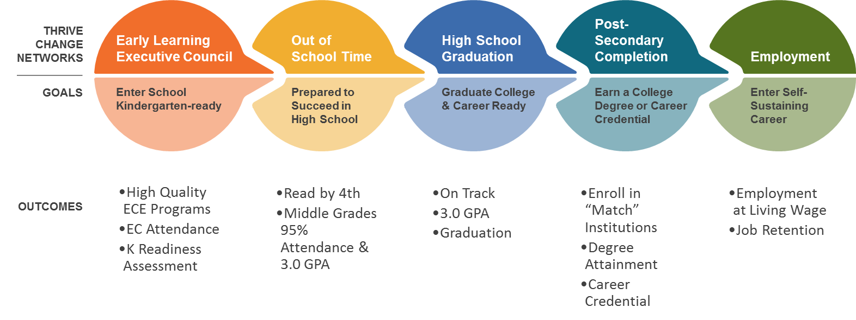
Thrive’s mission is to prepare Chicago’s youth for a vibrant future by aligning efforts and outcomes from cradle to career
Notes:
In 2017, Thrive’s focus is to ensure youth transition successfully into adulthood through school and work – i.e. we will solely focus our work in the High School, Postsecondary, and Employment change networks
Under each change network, we will stand up 2-3 Action Teams (including ones focused specifically on OY)

Slide 11
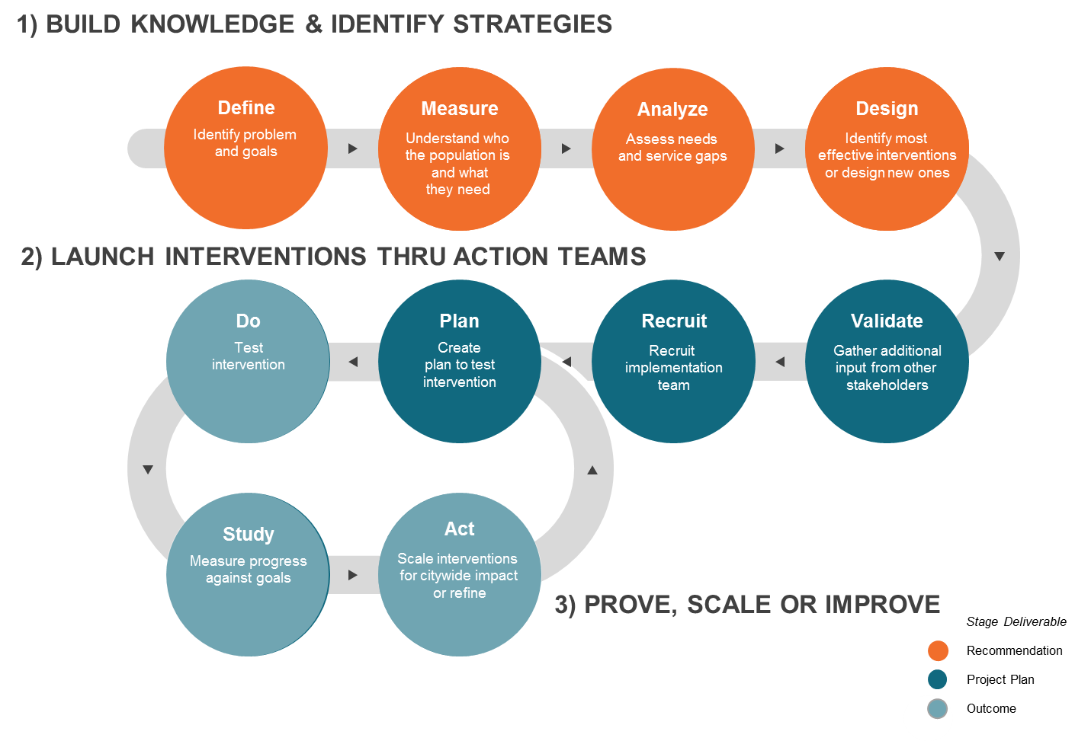
How Thrive Drives Collective Impact
Notes:
This is the lifecycle of a Thrive collective impact process. It is critical that we take the time upfront to first collectively define the problem, understand the current landscape, and design the solutions.
From there, the Thrive backbone’s responsibility is to validate the recommendations with audiences not represented in the initial stage. That includes youth, community, funder, etc.
Once we validate the recommendations, our next step is to recruit people to do the work for each of the action teams that will execute on a specific strategy and for them to come up with a project plan that includes a list of measures to track and associated costs.
From there, we test them, measure progress, refine and keep going until we accomplish our goal.
Last summer, Thrive shepherded an Opportunity Youth Working Group of 30+ cross-sector partners through this process to build new knowledge about OY in Chicago and produce a set of shared strategies for connecting them with employment and education pathways.
Partners included youth-facing public sector agencies, local funders, research institutions, youth leaders, and community-based service providers.
The first phase of this group's work involved synthesizing baseline demographic information about who opportunity youth in Chicago are, the second around assessing who serves them and where gaps exist, and the third around developing a set of shared recommendations based on these insights.

Slide 12
Snapshot of Preliminary OY Working Group Recommendations
Design reconnection “hubs”: Create community-based resources that assist opportunity youth navigate systems and provide a suite of services that can help them address multiple barriers in reconnecting to school and work.
Develop “earn & learn” programs: These are opportunities for youth to develop on-the-job skills in a learning environment while receiving wages for their work. These programs can come in the form of internships, apprenticeships, and permanent positions, which are usually coupled with a mentor or buddy and structured training.
Engage employers to hire more opportunity youth: Develop stronger commitments from employers to prepare and hire more opportunity youth, and foster partnerships between them and community organizations to retain and advance more opportunity youth.
12
Notes:
This is not an exhaustive list of opportunity youth recommendations developed by the OY Working Group. Thrive is working with our partners to host an OY Summit in early March to share more details on this front and to launch action teams around these ideas.
If your proposal lines up with any of the OY intervention ideas mentioned here, we would love to hear about it in your application.

Slide 13
Chicago 100K Opportunity Initiative Plan
Who
What
Goal
Chicago Cook Workforce Partnership
Mayor’s Office
Skills for Chicagoland’s Future
Chicago Public Schools
Department of Family and Support Services
Chicago Housing Authority
City Colleges of Chicago
One Summer Chicago
Chicago Community Trust/LRNG
Emerson Collective
Chicagoland Workforce Funders Alliance
Service Year Alliance
Economic Awareness Council
Cabrini Green Legal Aid
Legal Assistance Foundation
Other community-based orgs
1
Commit Employers
Local employers make on-the-spot job offers to opportunity youth
2
Recruit Youth
3
Prepare Youth
4
Match to Jobs
5
Provide Pre-Hire Supports
6
Provide Retention Supports
7
Development of Advancement Pathways
13
Notes:
As the anchor organization for the 100K Opportunities Initiative, Thrive works with a group of cross-sector to implement the plan outlined here to directly connect opportunity youth to real jobs with the companies that make up the 100K coalition of employers.
While we have so far focused on the first 4 steps along this continuum, we are eager to work with our partners in Chicago to especially build out #3 (preparation), #5 (pre-hire supports), #5 (retention supports), and #6 (advancement pathways) for youth hired through our initiative.
If your proposal involves innovating or scaling along any of the steps in this continuum, we’d love to hear about it in the application.

Slide 14
Pathways to Careers Fund
Eligibility Criteria
Projects must be implemented in Chicago/Cook County
Projects must be completed within 24 months of the start date
Projects must include collaboration with at least one employer
The applicant must be a non-profit organization
All applicants must be willing to collect and share summary data with Aspen, its evaluation partners, and the Demonstration City backbone organization, and have information about their project shared. All grantees of the Pathways Fund must be willing to participate in a third-party evaluation conducted by Equal Measure

Slide 15
Pathways to Careers Fund
Preferred Eligibility Criteria
Support retention, persistence, and opportunities to advance in employment
Feature employers as designers or co-designers
Scale an existing proven effort
Demonstrate innovation in pathway design
Focus on reducing racial inequities in employment and/or education outcomes

Slide 16
Pathways to Careers Fund Learning Plan
Our goal is learning for continuous improvement, not reporting/evaluation for compliance or grant management purposes
We understand that reporting and evaluation can be a burden for grantees, and will seek to minimize time needed for these activities
We respect client privacy and do not request any identifiable information at the individual level

Slide 17
Pathways to Careers Fund Learning Plan
Sample Learning Questions
Project level
Did investments/projects succeed in achieving youth outcomes and/or any systems change outcomes sought?
What lessons were learned in regards to what did or didn’t work during implementation?

Slide 18
Pathways to Careers Fund Learning Plan
Sample Learning Questions
Multi-site (summary) level
Did the projects happening in a region support and enhance that region’s OY agenda?
For employers, what are the largest challenges of doing this kind of work? Did projects help to move employers to create lasting, long term changes to hiring approaches?
Did increases in scale (eg. total number of OY employed) or quality (eg. persistence of OY in jobs) stick after the project period? Why or why not?

Slide 19
Pathways to Careers Fund – Aspen Learning Plan
Required Grantee Activities
Interviews with AFCS evaluation partner: twice a year, a one hour interview with an evaluation partner
Participation in learning sessions in your city, with AFCS staff: at most twice a year, participation in a half day learning discussion with other grantees
Written report: an annual and/or final report will be required, which will include reporting data on actual youth outcomes as they relate your proposed outcomes, and a narrative describing the process you used and successes and barriers you experienced
At the end of your project: potential phone interview with evaluators or AFCS staff
We estimate that our request to grantees for time related to learning should amount to less than 12 hours annually

Slide 20
Applying to the Pathways to Careers Fund
Proposal Components
Chicago/Cook County Application Cover Sheet
Proposal Narrative (not to exceed 8 pages; your response to section 1 should not exceed 1 page), including the completed diagram shown in Appendix D of the RFP
Letters of commitment and/or Memoranda of Understanding from employer partners of the proposed pathway or otherwise needed for the success of the project
If a K12 or post-secondary connected pathway, letters of commitment and/or Memoranda of Understanding from any educational institution partners
If the proposed pathway has any existing documentation of the approach or outcomes (descriptive report, evaluation, etc) please include as an attachment
Copy of organization’s 501(c)3 letter; if organization is applying as a fiscal sponsor for another organization, also include a copy of the fiscal sponsorship agreement

Slide 21
Applying to the Pathways to Careers Fund
Submission Process
Proposals are due, by electronic submission, to the attention of: Emma Uman, emma.uman@aspeninst.org
Deadline for submission is March 10, 2017 6:00 p.m. Pacific Time
Funding decisions will be announced before May 31, 2017

Slide 22
Questions?

